Slide 1
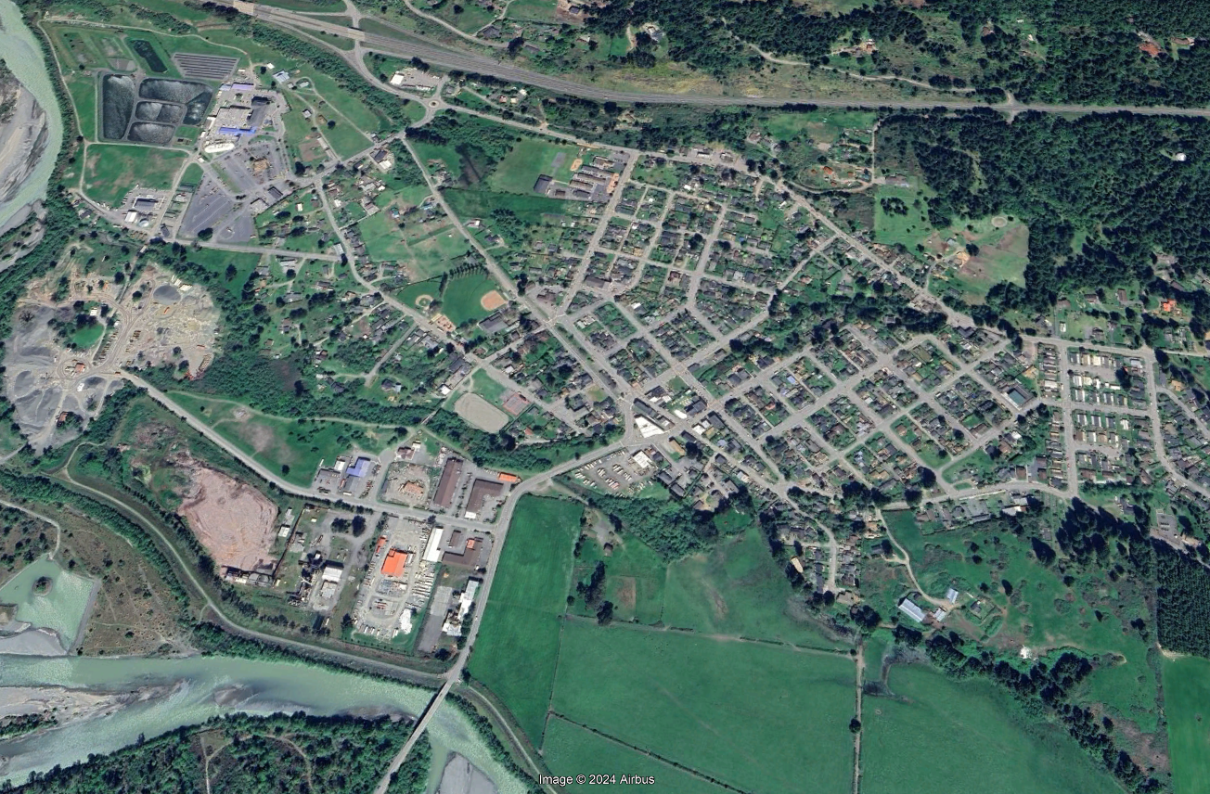
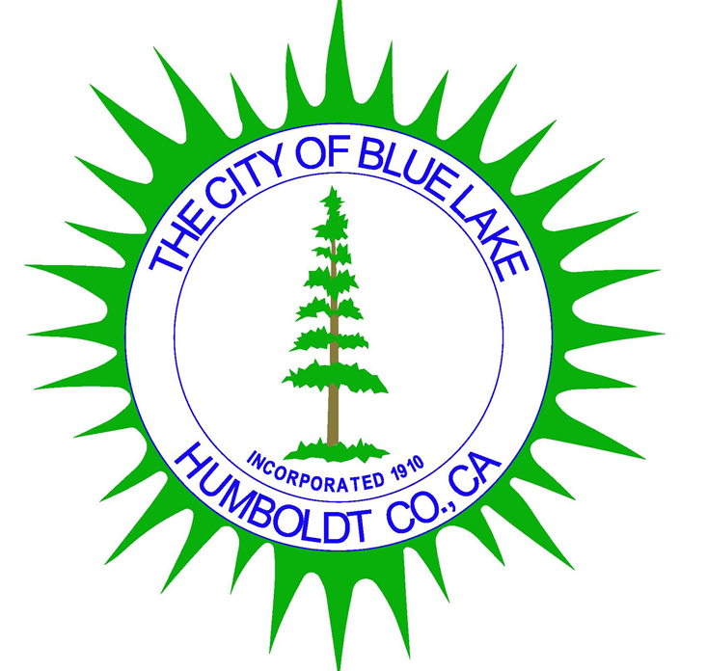
Blue Lake General Plan
Presentation to the Blue Lake City Council
July 23, 2024

Slide 2

What is a General Plan?
The Governor’s Office of Planning and Research (OPR) is the State’s Comprehensive Planning Agency
OPR defines a General Plan as:
The City’s blueprint for meeting the community’s long-term vision for the future
Establishes a consistent citywide vision and direction for existing and future development
Reflects community priorities, values, and includes supporting goals, policies, and implementation measures to achieve the community's vision

Slide 3
Required General Plan Elements
Land Use
Circulation
Housing
Conservation
Open Space
Noise
Safety
Environmental Justice

Slide 4

Blue Lake General Plan
Land Use Element (Amended 2021)
  Includes Open Space & Conservation Elements
Circulation Element (1986)
Housing Element (Amended 2009)
  Required to be updated every 8 years
  Update in process
Safety Element (1975)
Noise Element (1975)
Scenic Highway Element (1975; optional)
Downtown Element (1986; optional)

Slide 5
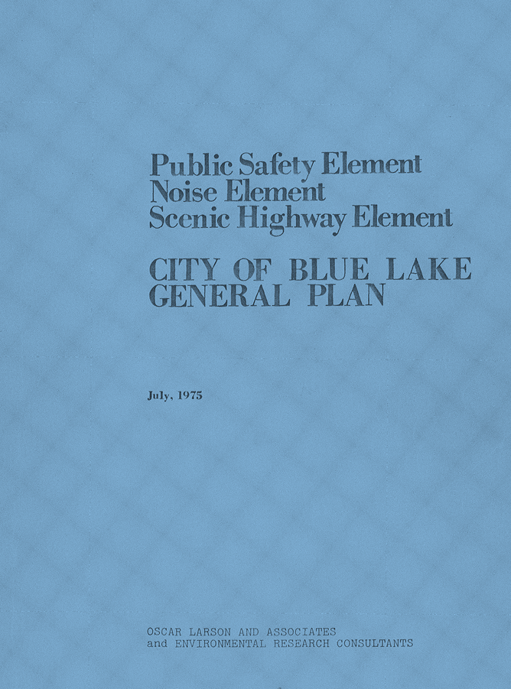
General Plan Elements - 1970s
Public Safety
Noise
Scenic Highway

Slide 6
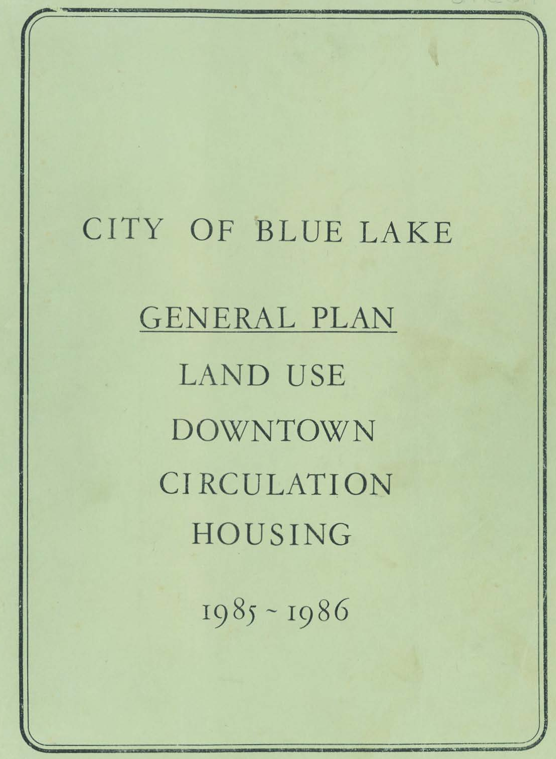
General Plan Elements - 1980s
Land Use
  Includes Open Space & Conservation
Circulation
Downtown
Housing

Slide 7
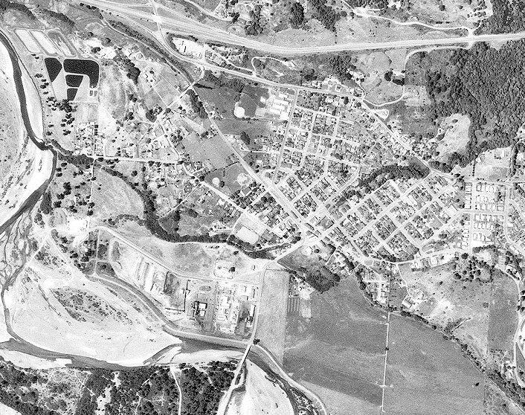
General Plan Buildout
Land Use Element (1986) considered:
Available vacant land at the time
Potential increase in population
  1940 = 503 to 1950 = 824 (↑64%)
  1950 to 1960 = 1,234 (↑50%)
  1960 to 1970 = 1,100 (↓11%)
  1970 to 1980 = 1,201 (↑9%)
  1980 to 1985 = 1,243 (↑4%)
Plan for Industrial Park
Plan for Downtown
Western side of City & PDR zone
  PDR (Planned Development Residential)
  Cluster residential to preserve resources
Aerial Photograph of Blue Lake, 1988

Slide 8
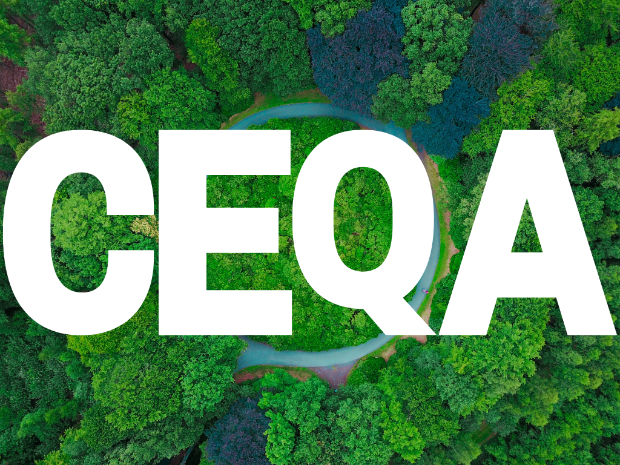
General Plan EIR
Analyzed projected buildout under the General Plan
Inherently a Cumulative Impact analysis
1982 EIR for Industrial Park Development

Slide 9
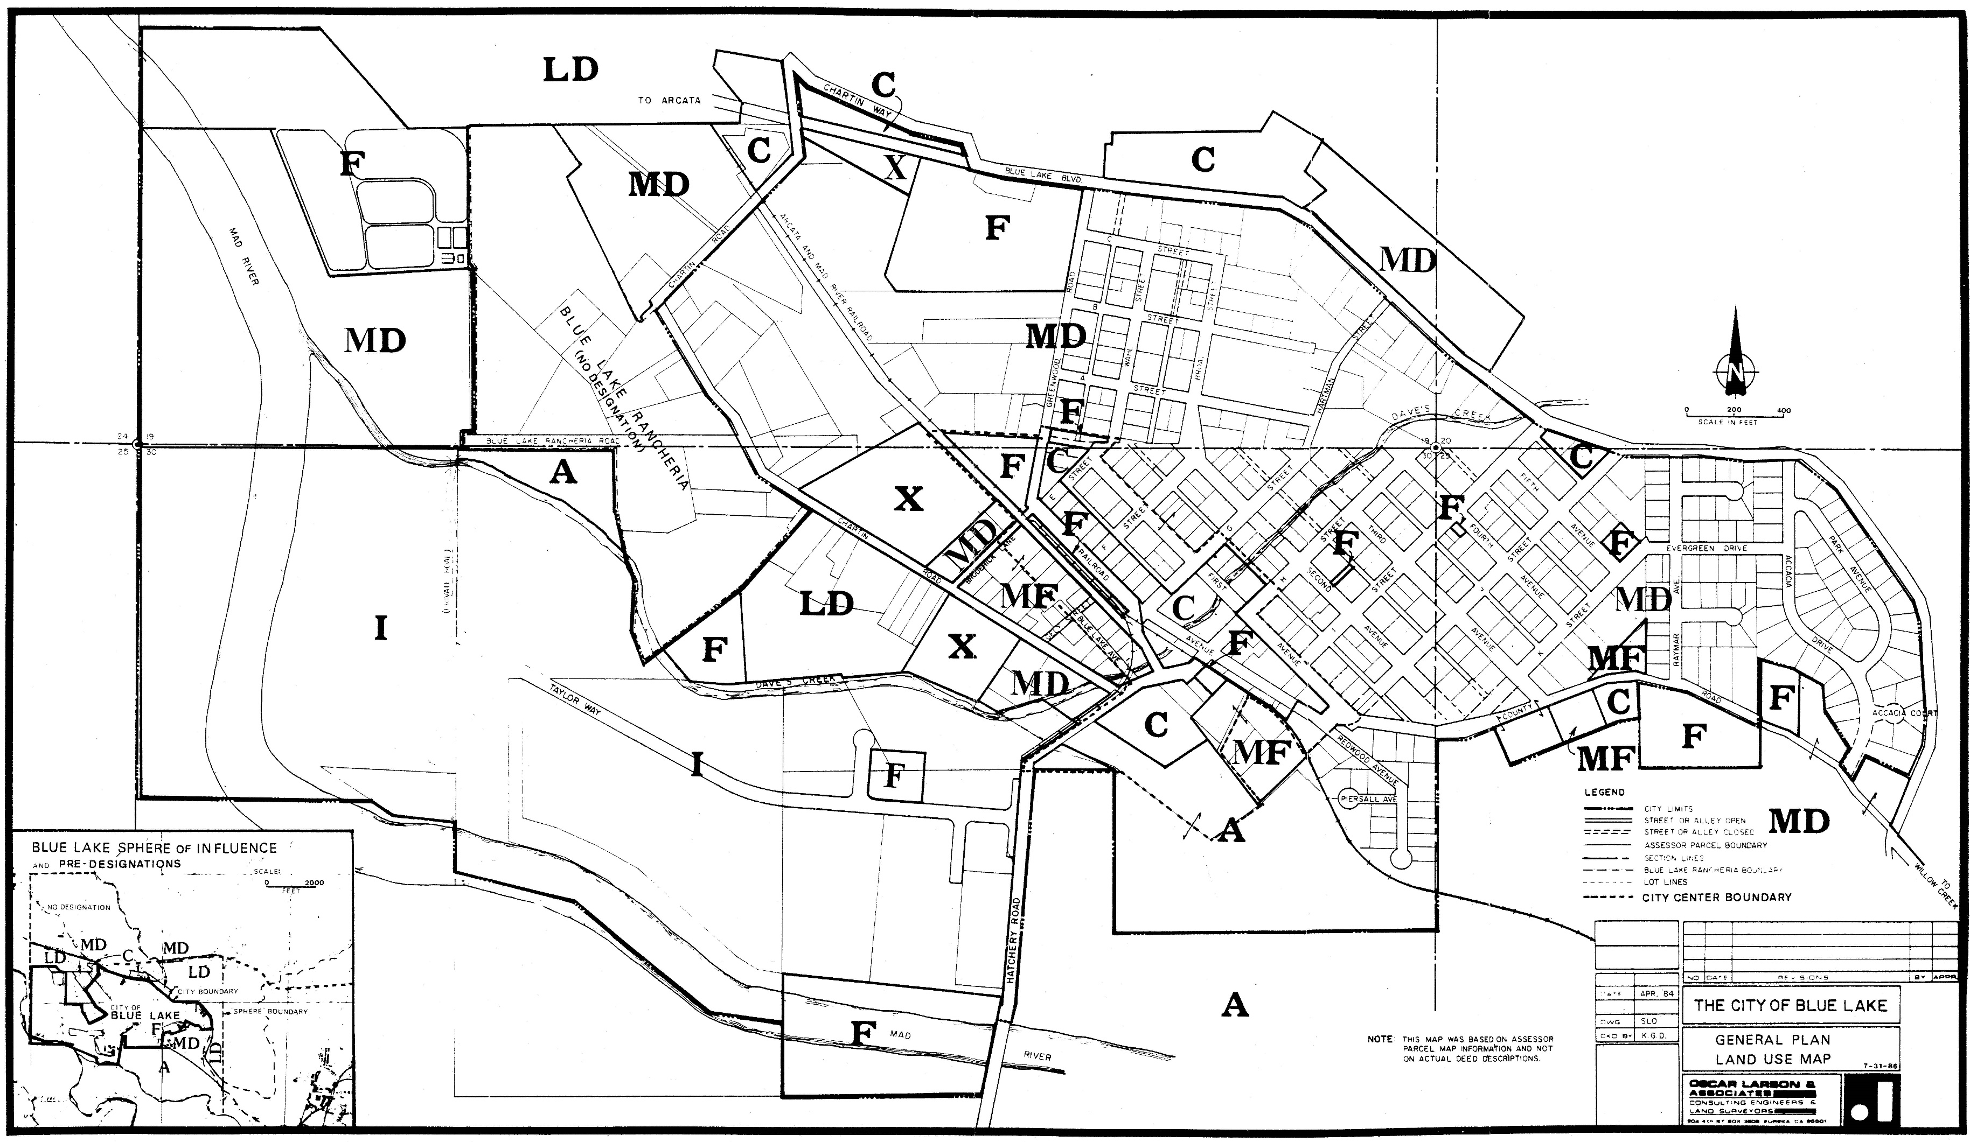
General Plan Land Use Designation Map - 1980s

Slide 10
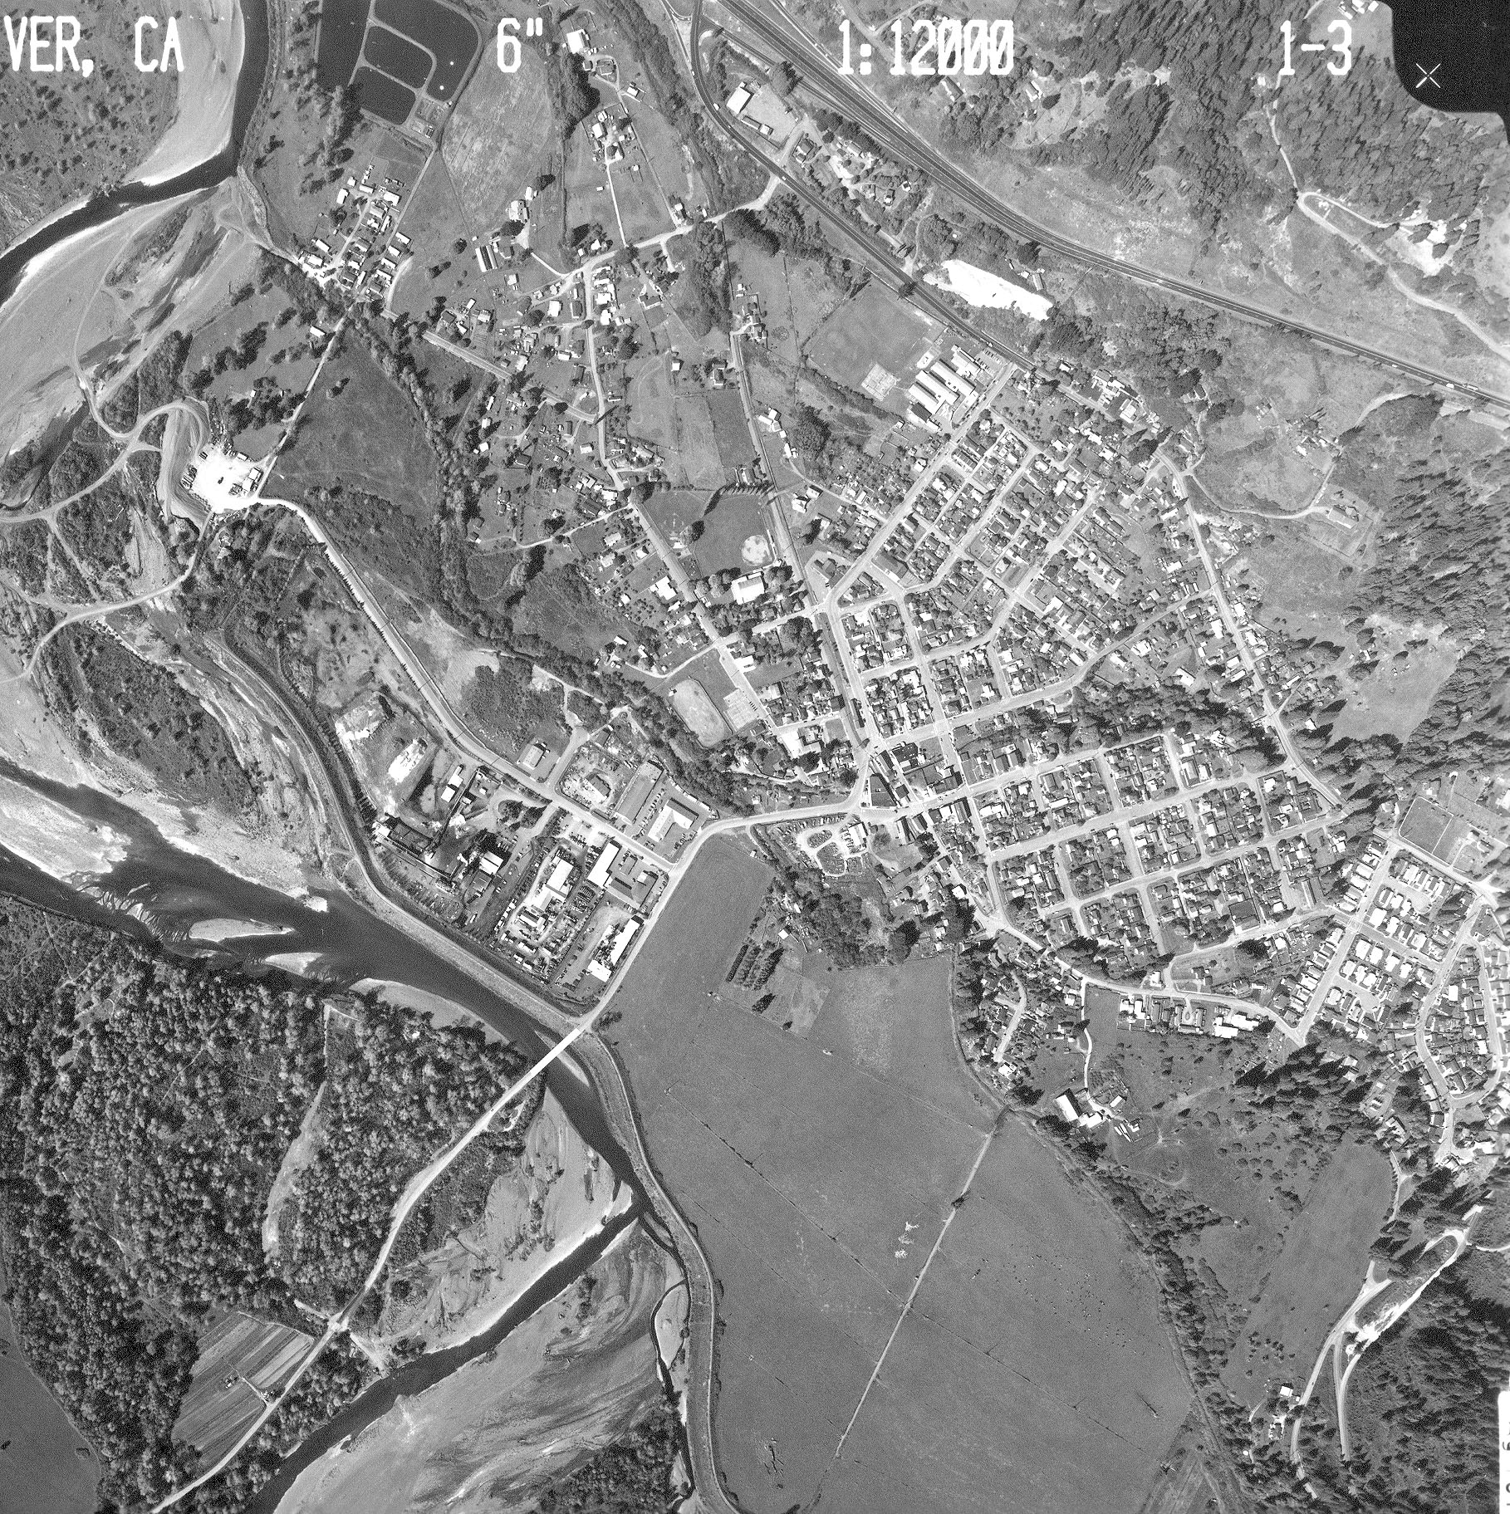
General Plan implementation over time
Industrial Park did not provide revenue needed
Downtown lost businesses and converted to residential
Population decreased
Transition to “Bedroom Community”
City in precarious financial position
Aerial Photograph of Blue Lake, 1997

Slide 11
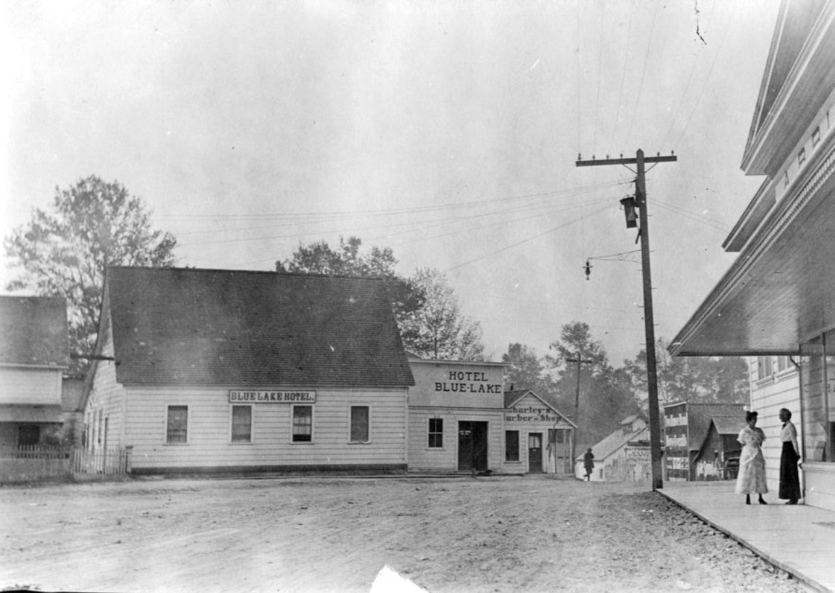
General Plan Amendments – Since 1980s
City incrementally amended General Plan due to changing community sentiment & community visioning efforts
  Mixed-Use designation and zone created and applied to Downtown in mid-2000s
  2009-2011 transitioned Industrial Park to Business Park
  2017-2021 transitioned Business Park to Power’s Creek District (PCD)
  Added Mixed Use designation & Opportunity zone to PCD
  Housing Element Updates (Amended 1992, 2004, and 2009; update in process)

Slide 12
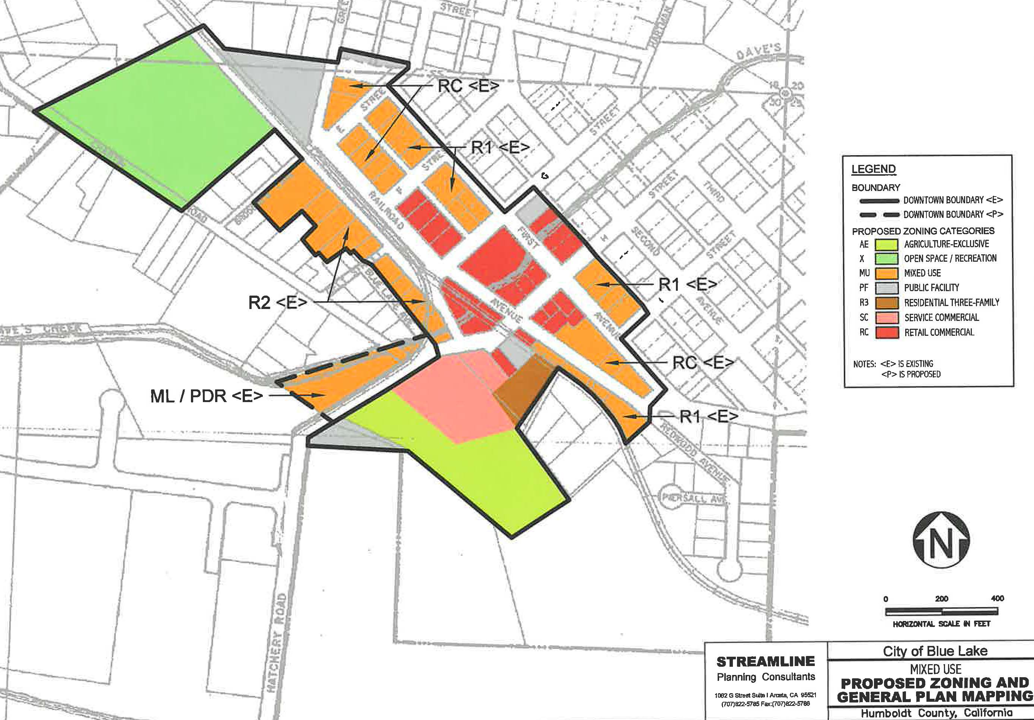
Mixed-Use Designation/Zone

Slide 13
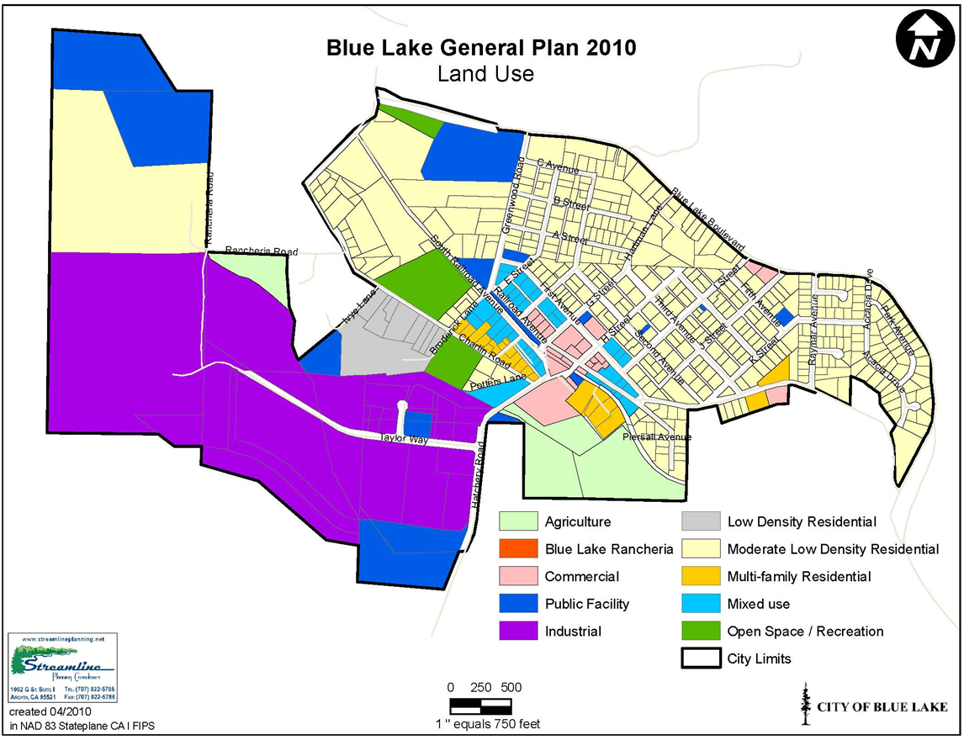
General Plan Land Use Designation Map 2010

Slide 14
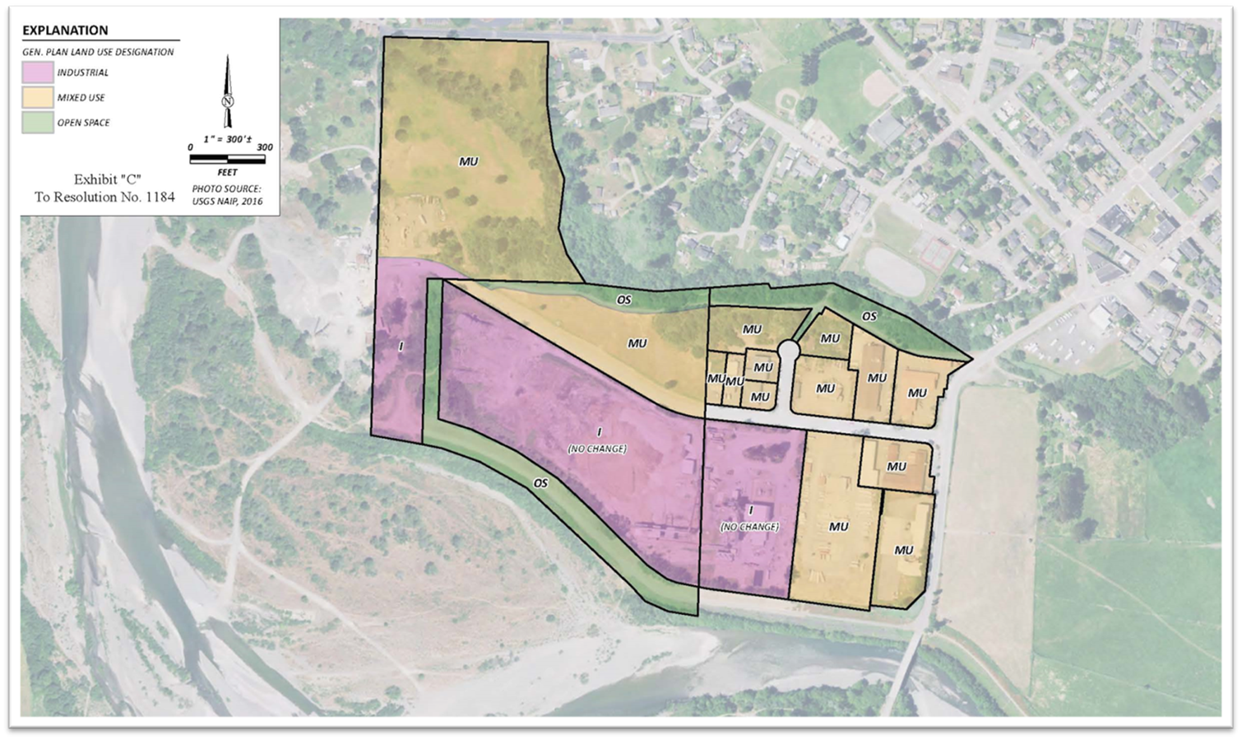
Power Creek District Redesignation/Rezoning

Slide 15

Where are we now?
Vision for Power’s Creek District (PCD)
Transitioning away from Industrial
Focus on Mixed-Use and Recreation
Subdivision of PCD to prepare sites for development
Reasonably foreseeable projects
  Submitted applications and/or ENAs
Housing Element Update for 6th cycle
Potential population growth for build-out under General Plan
  Plan for up to 2,000 population
  Population = 1,166 (2024) vs. 1,234 (1985)

Slide 16
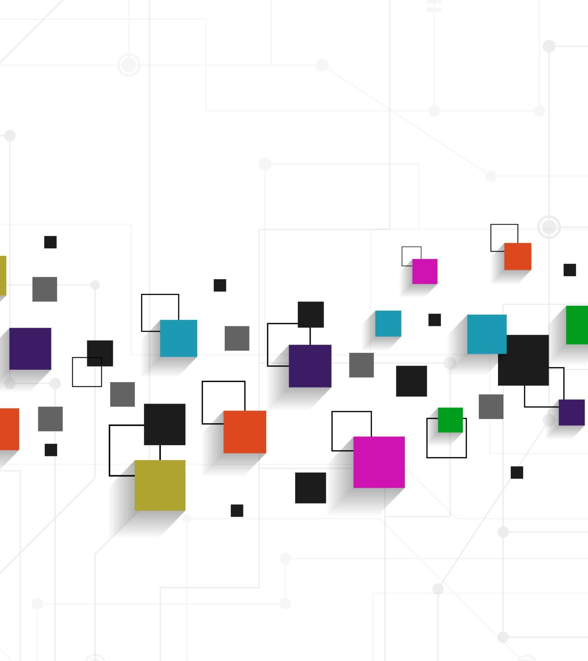
Modernization of General Plan
Purpose: To make the General Plan easier to review by the public and City staff
Use text recognition software to transfer scanned versions of the elements into a word processing program
Create individual pdfs of each element and a table of contents
Upload to the City’s website for easy access by the public

Slide 17
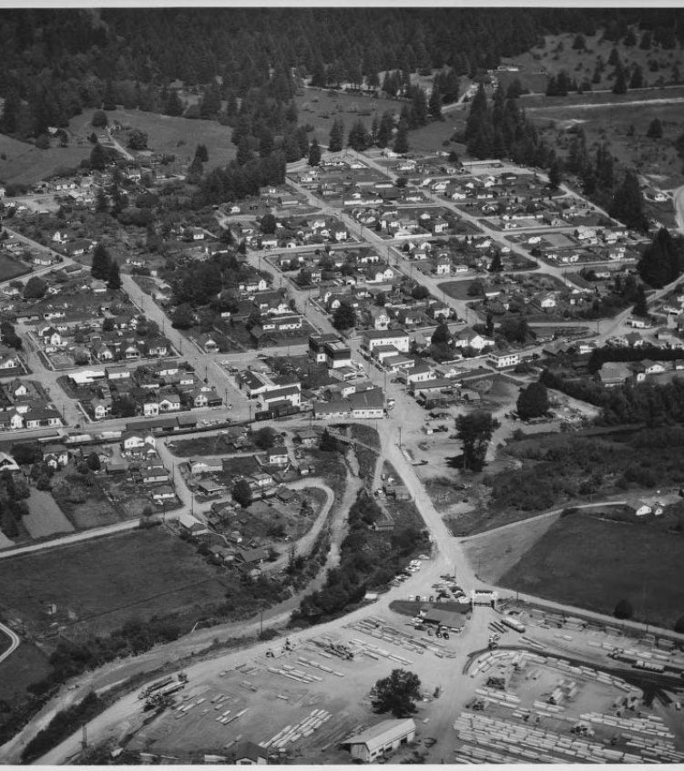
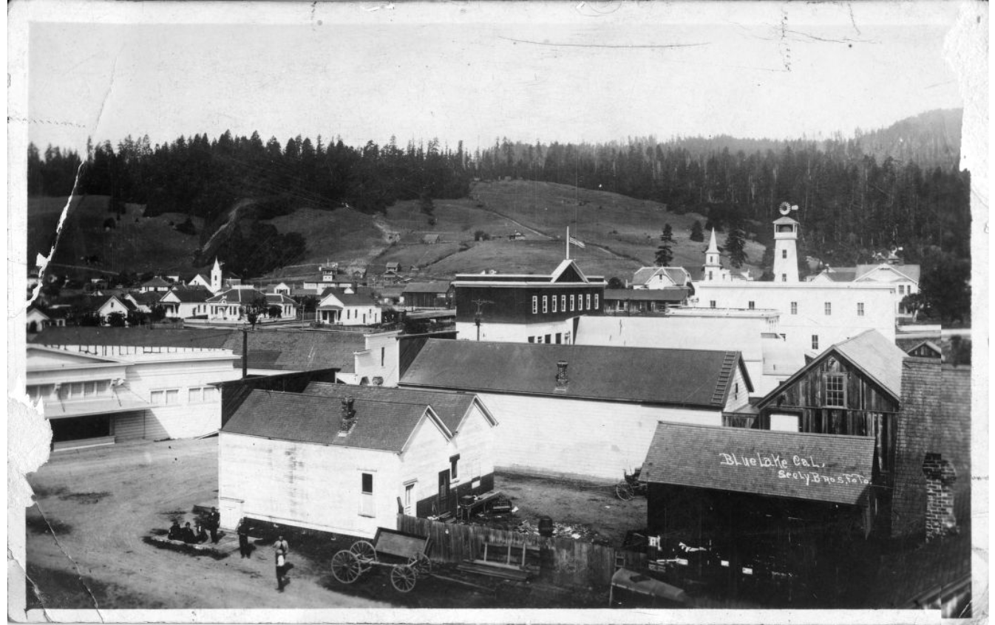
Questions?
Aerial Photograph of Blue Lake, 1953

